Slide 1

Pilgrimage
Genre: Adventure

Slide 2

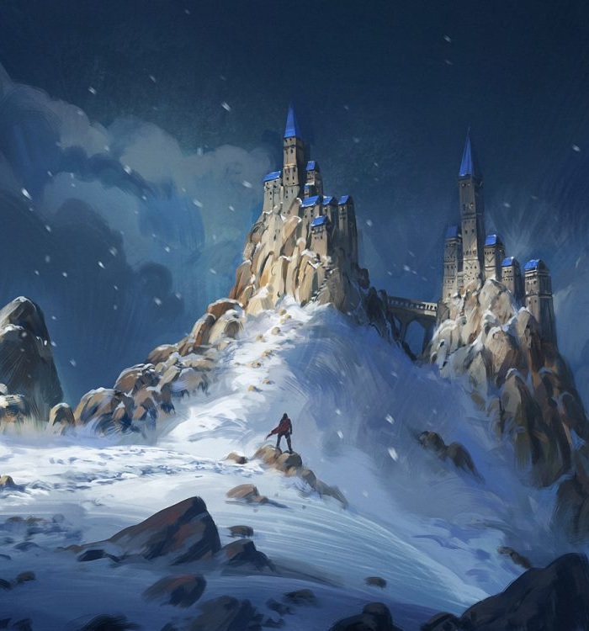
Storefront Description
Inspired by Journey and The Last Guardian, Pilgrimage is a First-person Adventure game set in the beautiful world of the Kingdom of Valaris. Join The Traveler’s spiritual journey as he ventures to his family’s grave to fulfil his brother’s dying wish using nothing but his acrobatic skills and his trustworthy bow.

Slide 3

Aesthetics overview

Slide 4

Aesthetics overview
Game Story:
In a world full of mysteries and monsters, the traveler ventures beyond the safety of his town, Seliana, to fulfill his brother’s dying wish, to have his remains scattered alongside his family. Join the traveler’s journey as he faces unfathomable creatures, reminisce his old memories, and treacherous paths as he fulfills his brother’s final wish. Follow the traveler as he grows as a person and learn to deal with the loss.
Game World:
We wanted a game world that is open that can also be served as a levels/stages, such as the world of Journey and The Last Guardian. There are several stages in the game and as the player progress in stages, the story progresses as well. In every stage, there will be some puzzles that mostly required to be solved in order for the story to progress, however there are some puzzles that are not compulsory. These are usually puzzles that contains secrets and lore to the game. Beware that in every stage, there will be enemies lurking, so players must be able to avoid these monsters as it may result in their death. As for the aesthetics, we want the player to feel perilous and natural during the journey, hence it will mostly consists of mountainous paths and forest meadows.

Slide 5
Aesthetics overview
Kind of Fun:
Sensation:
Our game will include beautiful landscapes and areas for players to explore as well as an interesting way to do this exploration.
Narrative:
We are planning to place an immersive story into the game, to show the players why our character is doing this journey and purpose of it.
Theme/Mood:
Theme: Spiritual Journey.
Mood: Transitioning from grief to acceptance as the story progresses.
Boundaries & Setting:
Boundaries: Cliffs, trees, inaccessible paths, etc.
Setting: Mountains and forest, occasional towns/small villages if possible.

Slide 6
Aesthetics overview
Characters:
Seeing as the plan is to make the player journey alone, as for the moment there will be only one character (The Traveler) and some enemies.
The Traveler
Aspects:
Hit points: 2 HP.
Cannot fight.
Avid Climber.
Equipped with Bow and arrow.
Enemies
Aspects:
Unkillable.
Roams in the land in every stage.
Have stages of detection.

Slide 7
MDA

Slide 8
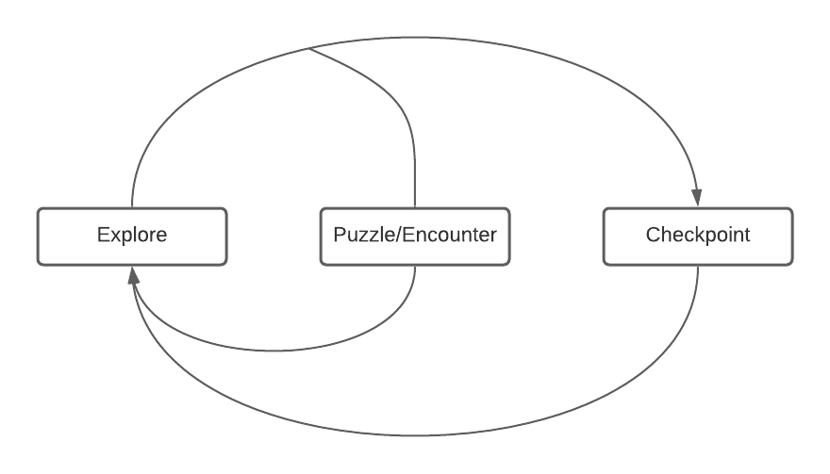
Core Loop
Explore:
Players will enter the world of Pilgrimage, where they can either focus on the story, or uncover the land’s mysterious secrets.
Puzzle/Encounter:
Players will often find themselves tangled with either a puzzle of some sort or an enemy encounter in which they must evade during the exploration.
Checkpoint:
Players will be met with a bonfire that serves as checkpoint before moving to the next stage. In this checkpoint, players health will be restored.

Slide 9
MDA
Wall-running:
The wall-running is the core mechanic in our movement system. This is inspired by the works of respawn entertainment Titanfall series. So the idea is to give players a more fluid movement in the game because the movement system needs to give players an easier way to explore the world of Pilgrimage, since the world is made up of many mountainous paths.
Bow:
The bow is used mainly for solving puzzles. The idea is that players will use the bow to shoot tiles or platforms with the bow to solve the puzzle. Of course the arrow will have a trajectory system in which the arrow will curve after a certain distance. This will make sure that the bow will feel more realistic to the players when they are using it.

Slide 10
MDA
Puzzles:
There will be puzzles inside the game. As for now the puzzles are platforming puzzle, where players need to maneuver to get to one place from another (Similar to Uncharted). The other would be the shooting puzzle, using the bow to shoot tile or platform to open a door or create a platform. This is to make the journey of the game more interesting and more intuitive.
No Combat:
There will be no combat in this game. Because of this, the players need to avoid being caught or detected by the enemies along the journey, otherwise they will be killed. The idea is to give players the sense of danger during enemy encounters. Of course, there will be a detection system for the enemies.

